Slide 1

RSA IMPLEMENTATION USING FPGA
Group No: 65
Project Supervisor
Rajeshwari Bhatt
Group Members
Nisha Chauhan 2000910310105
Nitin Singh 2000910310106
Riya Sharma 2000910310129
DEPARTMENT OF ELECTRONICS AND COMMUNICATION ENGINEERING

Slide 2
Project Presentation Outline
Title of the Project
Problem statement
Objectives of the project
Block diagram of project
Methodology
Work to be completed till next presentation
References

Slide 3
Title of the Project:
RSA IMPLEMENTATION USING FPGA
DEPARTMENT OF ELECTRONICS & COMMUNICATION

Slide 4
Problem statement:
Achieving efficient and secure encryption/decryption is essential. RSA, a key algorithm, is slow when executed on software, especially with significant data or real-time demands. A hardware-based approach is required to accelerate RSA computations for better performance and effectiveness.
DEPARTMENT OF ELECTRONICS & COMMUNICATION

Slide 5
Objective of the Project
Efficient RSA Operations
Key Generation, Encryption, and Decryption (Security Integration)
Hardware Acceleration & Real-time Performance
Documentation and Presentation
DEPARTMENT OF ELECTRONICS & COMMUNICATION

Slide 6
Methodology(Work Flow)
The RSA cryptosystem can be explained in only a few steps:
prime number generation, key generation, encryption, and decryption.
The RSA cryptosystem is based on two large prime numbers 𝑝, 𝑞 chosen at random at a set bit length such that p!= q and the multiplication of these numbers generate 𝑛 = 𝑝 ∗ ?𝑞. We then calculate 𝑝ℎ𝑖(𝑛) = (𝑝 −1)(𝑞− 1).
We then choose a public key e such that 1 <𝑒<𝑝ℎ𝑖(𝑛) and such that e is not divisible by 𝑝ℎ𝑖(𝑛). After this we can calculate the public key such that 𝑔cd(𝑝h𝑖(𝑛), 𝑒) = 1 (where e and phi(n) are relative primes.) We can then calculate our private key d such that 𝑑 =𝑒^(-1)𝑚od(𝑝ℎ𝑖(𝑛)) we choose a message m to generate a cipher text c such that 𝑐=𝑚^𝑒 𝑚od(𝑛) and decrypt our cipher to generate our original message m such that
𝑚=𝑐^𝑑 𝑚od(𝑛).
DEPARTMENT OF ELECTRONICS & COMMUNICATION

Slide 7
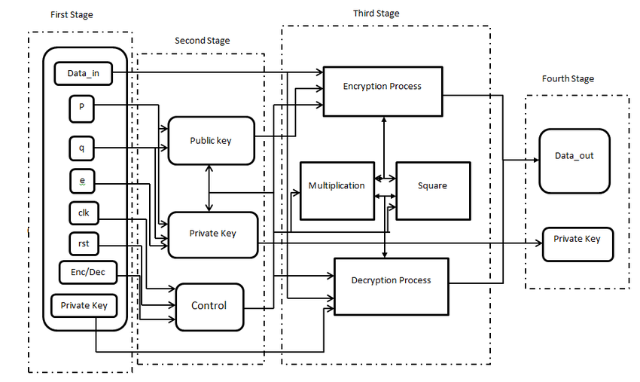
FLOW CHART
Conversion Of Plain Text To Cipher Text Using Public Key Encryption
DEPARTMENT OF ELECTRONICS & COMMUNICATION

Slide 8
ENCRYPTION
(Client.v)
Public Key
Private Key
Multiplier
DEPARTMENT OF ELECTRONICS & COMMUNICATION

Slide 9
KEY GENERATION
(Public Key)
Divider for client(16 bits)
DEPARTMENT OF ELECTRONICS & COMMUNICATION

Slide 10

DIVIDER 16 bits
DEPARTMENT OF ELECTRONICS & COMMUNICATION

Slide 11
DIVIDER 32 bits
DEPARTMENT OF ELECTRONICS & COMMUNICATION

Slide 12
MODULO MULTIPLICATION
Divider 32 bits
DEPARTMENT OF ELECTRONICS & COMMUNICATION

Slide 13
DECRYPTION
PRIVATE KEY(dnew.v)
Divider 16bits
DEPARTMENT OF ELECTRONICS & COMMUNICATION

Slide 14
Work To Be Completed Till Next Presentation
Implementing the Verilog code on FPGA.
Getting more familiar with FPGA and its features.
Providing with the full source code and implemetation of Verilog.
After this presentation , we’ll start with the paper publication work.
DEPARTMENT OF ELECTRONICS & COMMUNICATION

Slide 15
Software/Hardware
SOFTWARE USED (simulation) | HARDWARE USED (implementation)
Verilog language | FPGA(SPARTAN-3E Starter)
Xilinx_ISE_14
DEPARTMENT OF ELECTRONICS & COMMUNICATION

Slide 16
REFERENCES / LIST OF ACCESSED RESOURCES:
https://ieeexplore.ieee.org/document/6021216
https://iopscience.iop.org/article/10.1088/1742-6596/1641/1/012042
https://scholarworks.calstate.edu/concern/theses/76537633k?locale=en
https://www.ijser.org/researchpaper/Implementation_of_RSA_Cryptosystem_Using_Verilog.pdf
https://www.ijert.org/research/implementation-of-rsa-algorithm-on-fpga-IJERTV1IS5454.pdf
https://www.researchgate.net/publication/257416064_Cryptosystem_An_Implementation_of_RSA_Using_Verilog
DEPARTMENT OF ELECTRONICS & COMMUNICATION

